Slide 1

Configuration Management Tools

Slide 2
Configuration Management Tools
1. Configuration management
2. Application deployment
3. Task automation
4. IT orchestration

Slide 3
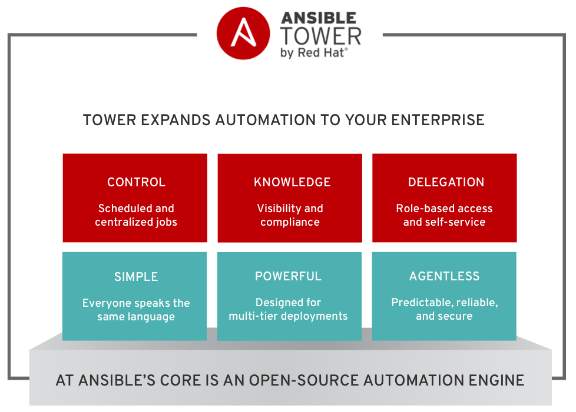

Slide 4
ANSIBLE
Ansible is an IT automation tool.
It can configure systems, deploy software, and orchestrate more advanced IT tasks such as continuous deployments or zero downtime rolling updates.
Ansible’s main goals are simplicity and ease-of-use.
It also has a strong focus on security and reliability, featuring a minimum of moving parts, usage of OpenSSH for transport
Ansible manages machines in an agent-less manner

Slide 5
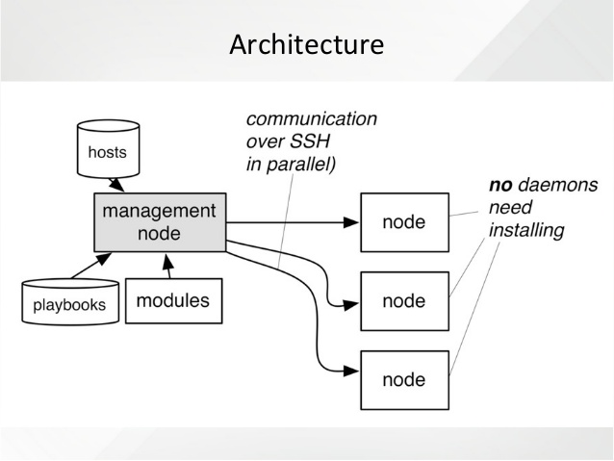

Slide 6
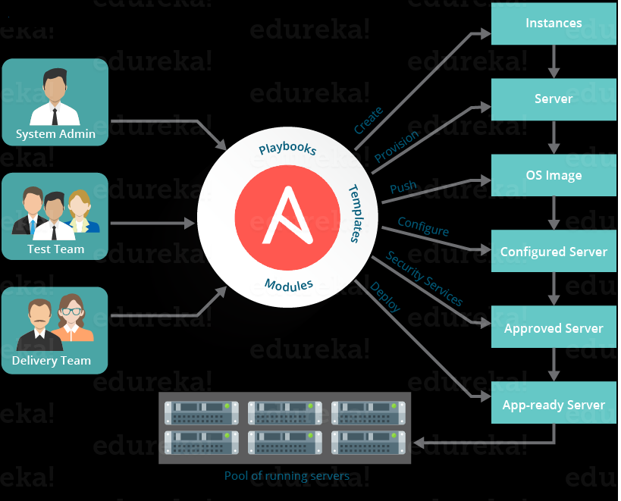

Slide 7
Ansible execution
Playbook
Inventory File
Trusted clients(passwdless)

Slide 8
ANSIBLE Installation
Installation on either Amazon Linux or RHEL
==========================================
Run below Commands
Launch Amazon Linux AMI
#yum install ansible --enablerepo=epel
#yum install python-boto
(or)
#wget https://dl.fedoraproject.org/pub/epel/epel-release-latest-7.noarch.rpm
#rpm -ivh epel-release-latest-7.noarch.rpm #yum update
#yum install ansible
#yum install python-boto

Slide 9
Automation with ansible
Example: Install httpd package in client machines
1. Create playbook with tasks
2. Create inventory file with client IP’s
3. Generate keys and copy public key on all client machines (to have passwdless)
4. Run playbook (deploy) ,it will install httpd package in all clients connected.

Slide 10
Playbook Creation(step 1)
To install httpd package in all trusted clients
#vim prog1.yml
- hosts: all
remote_user: ec2-user
tasks:
- name: Install httpd
package: name=httpd state=latest
sudo: yes
- hosts: all
remote_user: ec2-user
tasks:
- name: Install httpd
package: name=httpd state=latest
sudo: yes

Slide 11
Configuration
Step 2 #
#cat > hosts
Step 3 #
$ssh-keygen -t rsa
$cd .ssh
$cat id_rsa.pub
(copy the public key to client machines, append the key on authorized_keys file where you need automation)
192.168.2.123
192.168.3.122

Slide 12
Run Playbook
# ansible-playbook http.yml -i hosts
It will perform the change as mentioned in playbook
Conclusion :
default inventory file /etc/ansible/hosts
Ansible playbook will be executed in all servers listed in inventory file if keys are trusted
Example : #ansible-playbook http.yaml -i /project/hosts

Slide 13
ANSIBLE Commands
#ansible all –m ping
it will perform ping test servers listed in /etc/ansible/hosts file
#ansible all –m setup |more
Gather facts from server ,useful to know OS type and server model and config of client
#ansible-playbook prog1.yml --flush-cache
It will clear the cache (variables and data)
#ansible-playbook prog2.yml --syntax-check
To check the syntax if there are any errors
#ansible-playbook prog3.yml –check
Dry-run , it wont change anything and it will just check

Slide 14
Playbook2.yml
This playbook will remove httpd package in all client machines
#cat > prog2.yml
- hosts: all
remote_user: ec2-user
tasks:
- name: Install httpd
package: name=httpd state=absent
sudo: yes

Slide 15
Playbook3.yml
This playbook will execute command in all client machines
#cat > prog3.yml
- hosts: all
remote_user: ec2-user
tasks:
- name: Install httpd
command: /bin/touch abc xyz bahubali
sudo: yes

Slide 16
Launch EC2 Instance
# vi ec2.yaml
#ansible-playbook -i local ec2.yaml
---
- hosts: localhost
tasks:
- name: launching EC2 instance
ec2:
key_name: ansible_key
instance_type: t2.micro
image: ami-aa5ebdd2
group: naresh1
vpc_subnet_id: subnet-77a6c52f
region: us-west-2

Slide 17
To run commands/script on client machines
command: /sbin/reboot;useradd
script: /bin/sh play.sh 15
raw: echo “Hello World”
shell: /bin/sh play.sh > /var/tmp/output.out

Slide 18
Example:run script on client machines
# vi play6.yaml
===================================
- hosts: dev
remote_user: ec2-user
sudo: yes
tasks:
- name: Copy the script
copy: src="script1.sh" dest="/tmp/"
- name: Set permissions
file: path=/tmp/script1.sh owner=root group=root mode=0755
- name: Execute the script
script: /bin/bash /tmp/script1.sh

Slide 19
Ansible Role
Example:: Create a Web Role to install httpd package and execute this role from playbook.
Step 1:
$ vi newplay.yml
Step 2 :
$ ansible-galaxy init webrole
- hosts: all
remote_user: ec2-user
sudo: yes
roles:
- webrole

Slide 20
Step 3 :
$ cd webrole/
$ vi tasks/main.yml
Step 4:
[ webrole]$ ls -ld
defaults files handlers meta README.md tasks
templates tests vars
Note: All these folders will get created by default
Step 5 :
$ cd ../
$ansible-playbook -i hosts newplay.yml
Note: This yaml file will execute the role (webrole) and install the package httpd as mentioned in webrole/main.yaml file.
---
# tasks file for webrole
- name: Install httpd
package: name=httpd state=latest

Slide 21
Template

